Slide 1

Securing Your API Endpoints A practical guide to API authentication
@spetryjohnson

Slide 2

My rookie mistake
Notes:
I have a confession to make. A few years ago, I made a huge rookie mistake.
I was writing a feature and I wanted a piece of JavaScript to make an API call back to my server. But since my team develops a fairly standard server-rendered web app, we didn’t have a lot of experience doing this, and one of the problems I encountered into is that I had no idea how to associate that API call with the current user.
The issue of course is that RESTful APIs are normally stateless, so unlike our other code, this API couldn’t just rely on the server automagically knowing who was currently logged in. We had to introduce some sort of API authentication scheme to do that.
Anyone here ever google “how to authenticate an API”? I did and found a pretty confusing mess:
Bearer tokens, nonces, federated identity
Correct cryptographic hash function when signing requests
Two different versions of this thing called Oauth
Things called web tokens that some people say are God's gift to the internet, and other people call a scourge on all mankind
There was no “guide to choosing the right authentication for you”
So… I did a bad thing. In a hurry, rolled my own, got it wrong and shipped a security defect.

Slide 3
Today’s goal: No more rookie mistakes!
Notes:
My goal today is to give you the coherent overview I desperately needed back then.
I’m going to break down all of the complex terminology and compare and contrast the techniques you can choose from.
Next time that you need to choose how to secure an API endpoint, I want you to start from a place of knowledge so that you can make an educated decision and not a rookie mistake.

Slide 4
What’s on the agenda?
Identity vs Authentication vs Authorization
Compare/contrast security techniques
Finding the best one for YOU
Notes:
Here’s the basic structure of this talk.
First, we’re going to talk about three different concepts that you, as an API author, should be thinking about when choosing an authentication solution.
Then we’ll use those concepts to compare and contrast all of the techniques you can choose from when authenticating your API calls. We’ll cover everything from HTTP Basic Auth to OpenID Connect.
Finally, we’ll wrap up with some suggestions for selecting a technology to match your use case.

Slide 5
This is not an advanced security session!
Notes:
Also, I want to be clear about what this session is NOT.
First, I am not a security expert and this is not an advanced security session. If you already know the difference between OAuth 1 and 2, how to sign a request using HMAC, or how to use JSON Web Tokens to replace server-side sessions, then you’re probably in the wrong place. My intended audience is people who DON’T know those things, or even that those are the things they need to know about in the first place.

Slide 6
This is not “getting started with <foo>”
Notes:
Second, this is not a “getting started with foo” style talk. In fact, there are things in this talk that I have no direct hands on experience with. I’ve never written any oAuth code myself, so I couldn’t tell you how to get started even if I wanted to.

Slide 7
This is “understand your options”
Notes:
However, I have done a lot of research about OAuth and how it compares to the other options, and that’s what this session is about.
I’ve packaged up all of that research and distilled it into the most coherent format I could create. I want to help you narrow the universe of possibilities to the one or two technologies that are most suitable for your use case.
I’m about to turn on the firehose, and if I go too fast please feel free to stop me and ask questions. This presentation, along with all of my speaker notes, is on my public Github if you want to refer to it later. I’ll give you a link at the end.

Slide 8
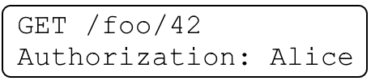
Identity / Authentication / Authorization
Identity: user data
Authentication: which user is this request for?
Authorization: is this request permitted?
Notes:
Subtitle is “A practical guide to API authentication” but actually talk about three different concepts: “identity”, “authentication”, and “authorization”.
Related but different – need to consider separately when making security decision.
Identity is your app’s concept of a user (Alice)
Authentication is process through which we securely associate identity w/ request (is it really Alice? Someone working on her behalf?)
Authorization is process through which we validate IDENTITY’s PERMISSION to perform
Just because a request is authenticated doesn’t mean its authorized, and just because a request is authorized doesn’t mean its authenticated. We’ll talk about that when we get to oAuth

Slide 9
Identity / Authentication / Authorization
Not all APIs care about all 3 things
Access control often your app’s responsibility
Notes:
Not all APIs care about all of these things.
Google API key for IDENTITY = rate limiting
Twitter cares about all 3
Point is that before you can pick an authentication strategy, you need to understand what problems it needs to solve.
Lastly, no matter how you authenticate, your app will still be responsible for some amount of access control.
Your custom business rules are the only thing that can know for sure if Alice is allowed to view data for Foo #42.

Slide 10
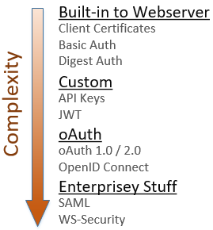
Notes:
So, how do you authenticate and secure your API endpoints? Here are the things I’ll be discussing today:
* Standards-based things directly supported by your web server, require very little code
* Custom implementations require more code, provide more flexibility
* Different flavors of oAuth and how they relate to OpenID Connect
* Time permitting, I'll talk briefly about SAML
Again, this session is not a tutorial on how to integrate these into your app. I just want you to understand at a high level how each of these things works.

Slide 11
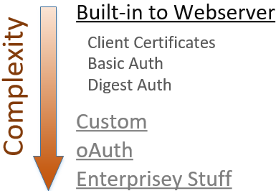
Notes:
The simplest way to secure your API is to use the authentication features built directly into your web server platform.
These 3 solutions are standards-based, are supported by all major web servers, and using them generally requires very little custom code. If you need something quick and dirty, start here.

Slide 12
Client certificates
“Reverse TLS” – proves client identity to server
No usernames or passwords
Ideal for internal apps, not public facing
On IIS, only “simple” w/ Active Directory
Notes:
The 1st of those techniques is “client certificates” = “reverse TLS”. In TLS, cert on server proves identity to client.
Client certs do the same thing, but in reverse. You install the certificate on your browser, and it proves your identity to the server. The same tech that tells you it’s safe to give your credit card data to an e-commerce site tells the server that a request is coming from a verified person and hasn’t been modified in transit.
No login screens, no redirects, every request instantly authenticated.
Drawbacks:
1) all users have to install security certs. Doesn’t scale.
2) Secondly, when using IIS, this is only a “simple” approach when authenticating against Active Directory because the tooling to link a client cert to a specific identity is built into Windows. If you want to authenticate against your custom user database it’s definitely possible, it just takes some more work.
These drawbacks mean that client certs are best suited for internal APIs on a secure network

Slide 13
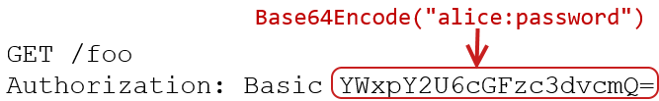
HTTP Basic Authentication
Notes:
If you don’t want to deal with client certs, the next simplest approach is HTTP Basic Authentication.
* Internet standard, supported by all major browsers, easy
* Username and password are concatenated together and Base64 encoded and sent with each request as a header

Slide 14

HTTP Basic Authentication
Notes:
When the server receives the request, it Base64 decodes that string back into its original format and parses out the username and password which are then used to authenticate the request.
Remember that Base64 encoding is not encryption, so the server doesn’t need any special keys to convert this back into the account credentials. But since this header is being sent over the wire with every request, you must use TLS to secure every single connection when using Basic Auth. It also means you’re only as secure as the underlying TLS implementation; if TLS gets cracked, like SSL did before it, these credentials are at risk of being stolen.
Note that the “Authorization” header is poorly named. This is authentication, not authorization.

Slide 15
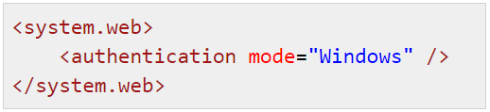
HTTP Basic Authentication
Active Directory supported “out of the box” on IIS
Easily authenticate against custom database (ASP.NET, WebAPI, OWIN)
Notes:
Setting up Basic Auth is really easy. If you’re using IIS, you get authentication against a Windows domain “for free” with a simple web.config setting.
For a public-facing website you’d probably want to authenticate against your custom user database. Most platforms make that very easy to do. For example, in ASP.NET or WebAPI you can write a tiny bit of middleware and override a few methods to provide the custom database queries that are needed.

Slide 16
HTTP Basic Authentication - drawbacks
Revoking access requires password change
Credentials passed as clear text – requires TLS
Notes:
Basic Auth is very easy, but has two main drawbacks:
1) API client has access to the primary account password
Only way to revoke access to that client is to change the account password
Impacts ALL clients using those same credentials
2) Credentials passed on every request & in the clear.
Remember that Base64 encoding is reversible
Use TLS on every secured request, because TLS encrypts the request as it travels over the wire
Only as secure as the TLS implementation

Slide 17
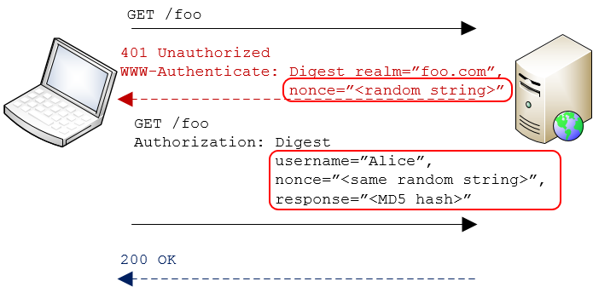

HTTP Digest Authentication
Notes:
An alternative to Basic Auth is another standard called Digest Auth
Main difference is that with Digest, the password is never sent over the wire, so there’s less risk of it being compromised.
Clients makes a secured request
Server responds “not authorized” & includes a “nonce”

Slide 18
HTTP Digest Authentication
Notes:
The browser then prompts the user for credentials, concatenates the username, password, and nonce together, and creates an MD5 hash of the result.

Slide 19
HTTP Digest Authentication
Notes:
Browser then resubmits request, passing the username, the nonce, and computed hash value in clear text as part of the Authorization header. (Again, the header is poorly named – this is still authentication, not authorization). The password itself is not sent over the wire.
Server then takes the username, looks up the user’s password, re-calculates the hash, compares it to what client sent
Only way hashes match is if client and server used same password to calc hash == proof of identity

Slide 20
HTTP Digest Authentication
Easily integrates w/ other standards-based systems
TLS not required
Notes:
Just like with Basic Auth it’s very easy to integrate with systems that support the standard.
And since the password itself is never sent over the wire, you can safely use Digest Auth without a secure connection.
In fact, The purpose of the nonce is to make sure that every request results in a different hash value, so that an attacker can’t brute force attack the hashes to reverse engineer the password.
However, there are two significant drawbacks to using Digest authentication. The first is that MD5 has been broken, so those hashes aren’t as secure as we’d like.
There’s another issue too – so just to see if you’re awake, can anyone guess why Digest is not used very much any more?

Slide 21
HTTP Digest Authentication
Easily integrates w/ other standards-based systems
TLS not required
Prevents storing passwords with strong encryption!
Notes:
The biggest issue with Digest authentication is that it prevents the use of strong password encryption in your database! This is because the server must be able to take a username and obtain its plain text password in order to verify the hash.
But the whole point of modern password security is to make this impossible! The use of any one-way encryption method, such as salting and hashing passwords, will prevent you from using Digest Authentication.
Because of this issue no one really uses Digest for API authentication. But it’s important to understand the concepts behind using hash values to avoid sending sensitive data over the wire because those patterns are going to come up again and again.

Slide 22
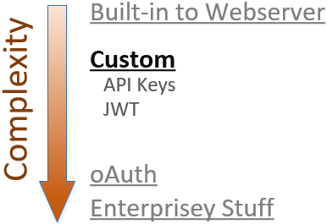
Notes:
Those 3 things work great if you want the API client to present actual user credentials during authentication, and if you’re OK with the constraints those techniques include. But what if those constraints are too limiting?
If you need more flexibility, either in terms of what information you use to authenticate OR how that information is transmitted, then the next simplest approach is to implement a custom scheme using API Keys or JSON Web Tokens.

Slide 23
API Keys
Use something other than primary account credentials as proof of identity
Notes:
Let’s talk about API Keys first.
With Basic and Digest Authentication, the client provides the primary account username and password as proof of identity. And that’s perfectly fine when the owner of those credentials is logging into a website or something.
But it’s a good idea, for many different reasons, to NOT rely on the account username and password in your API calls. If you’re passing around the primary account credentials with each API call, and something goes sideways and those credentials get stolen, then the entire account is compromised. The user has to change their password, which then breaks any other APIs that are using those same credentials. And if that person is reusing their credentials across different websites, then their exposure to harm is even greater.

Slide 24
API Keys
Use something other than primary account credentials as proof of identity
Revocable
More secure
Notes:
If you assign a unique API Key to each integration point, and you use that key as proof of identity instead of the account credentials, then it’s simple to revoke access from one integration without impacting any others.
And since API Keys are generally system-assigned, they tend to be unique for each site. If an API Key does get compromised, the attacker can only use it to access your system. They can’t take that key to any other system and gain additional access.
There is no “standard” of what an API Key should look like, but in most cases they are GUIDs or some other long, random, unique string. Since we’re using one single value as proof of identity, these obviously need to be hard to attack with brute force.
There are two different ways to use API keys for authentication…

Slide 25
API Keys as "bearer tokens“
Pass the key in plain text with each request
Anyone that has the key, gets access; requires TLS to keep safe!
Notes:
The simplest approach is to treat the key like a password and pass it over the wire with every request.
This is called a "bearer token" because anyone that has that API Key may use it to authenticate as a specific user; there's no additional security.
And since you're passing the raw account credential over the wire, you MUST use TLS on all requests to keep it secure.

Slide 26


API Keys as "bearer tokens“
Via querystring (using TLS)
Via header (using TLS)
Notes:
You can pass the API Key in either the querystring or an HTTP header.
Querystring really easy to do - ideal for scripting scenarios.
Generally headers are better
Header is more secure – not in log files. Wouldn't want plain-text passwords to be stored in unencrypted log files
Header can’t be leaked via copy/pasting a URL out of Fiddler or the browser's URL bar.

Slide 27
Trade-offs when storing bearer tokens
You can have secure storage of API Keys
–or –
the ability to show users a list of their keys.
Not both!
Notes:
Using API Keys as bearer tokens is very easy, but there is one significant trade-off you need to think about. You can either have secure storage of API Keys or the ability to show users a list of their keys. Not both.
Since API Keys are basically account passwords, you should consider salting and hashing them when you store them in the database. If you store them as text, and someone were to get access to your database, they would gain access to everything they need to impersonate every user in your system.
But if you salt and hash the API Keys when you store them, it will prevent you from showing a user a list of their API Keys. That’s kind of the whole point; you want your system to be able to verify a bearer token API Key, but not decrypt it to plain text, just like with passwords.
If you decide to store these things as plain text, then you should at least implement an expiration policy to limit the vulnerability window if the database is compromised.

Slide 28
API Keys as cryptographic keys: HMAC
Custom version of Digest Auth, using API Key instead of password
Does not prevent secure password storage
Notes:
The other way to use API Keys is to use them as a cryptographic key, and digitally sign the HTTP request.
This is basically a custom version of Digest Auth, but we use an API key to sign the request instead of a password. This allows us to continue to protect the primary account password with full encryption.

Slide 29
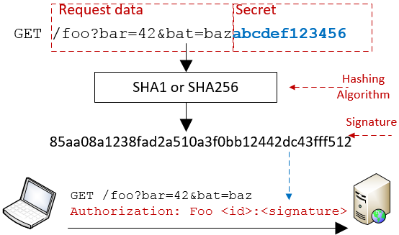
Notes:
Here's how signing works with API keys:
Client prepares the message which is either a URL or form post
Client concatenates the message with the API Key & runs result through a hashing function = signature
Client sends original message to the server, plus signature in a header
Server looks up client's API key and repeats hashing operation
If they match, server knows that client used same API Key AND message wasn’t modified in transit
The authorization header is type of “message authentication code”, or MAC. Since this technique uses a hash it’s called a “hash-based message authentication code”, or HMAC.

Slide 30
API Keys as cryptographic keys: HMAC
Signed requests == sensitive values not transmitted
Does not require TLS to keep secret safe
Server ensured of message authenticity
Notes:
HMAC has a lot of benefits.
First, no credentials are sent over the wire, so this does not require TLS. Unlike with bearer tokens, if an attacker intercepts a signed message they don't gain the ability to compromise the account.
Note that the message itself is sent in plain text, so if URL params or form data is sensitive then you should still use TLS. We're just not sending account credentials in plain text
In addition, the recipient of the message can verify that the message contents were not modified in transit. If a middleman manipulates the message in any way, of if the server and client disagree on the secret value, the hashes won't match.

Slide 31
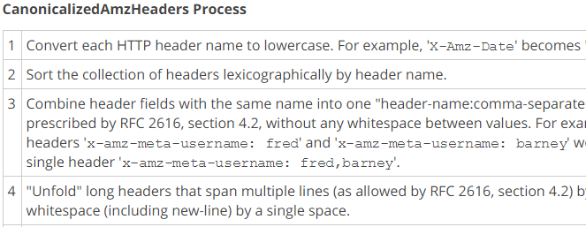
HMAC Drawbacks
Client and server must compute hash exactly same
Notes:
The primary drawback to HMAC is complexity.
* Client and server must compute the hash EXACTLY the same way.
* Usually requires publishing detailed instructions that describe how to “canonicalize” the request data
This image is a tiny piece of just one portion of instructions for canonicalizing an AWS API call.
* Client and server must agree on which headers to include. If middleware network component adds a header to the request, server will calculate different signature.
This complexity is a necessary part of using HMAC. It’s the price you pay for the increased security that signed requests provide.

Slide 32
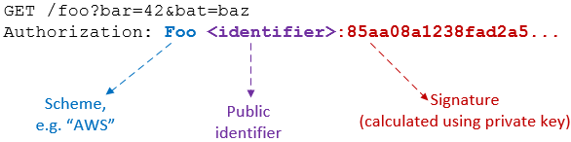
Signed requests using HMAC
Notes:
In order for signing to work, the request must include at least two things:
The signature created with the API Key
A pointer to the identity that created the signature
Identity indicator is required so server can look up the API Key that it needs to verify the signature.
This means that if you build an HMAC system you’ll have to choose what to use as the identifier and what to use as the secret value.
You could use the user's ID or email address as the identifier, but that makes it harder to support multiple API keys for a single user. The server needs a way to determine the specific API key the client used to sign the request. If you pass the user ID as this identifier, and that user is associated with multiple API keys, then you'll have to compute multiple hashes to verify the request.
A better approach is to issue API Keys as a pair – one public key, that's sent over the wire in plain text as the identifier, and a private key that's used in hashing.

Slide 33
HMAC: API Key storage
Must be something app can retrieve in clear text
Add expiration timeout if necessary
Notes:
Remember that to do request signing, API Keys must be stored in plain text or using reversible encryption. App needs it to verify sig.
Storing in text means it can be compromised if an attacker gains access to your database. To combat this, implement an expiration policy for your API Keys

Slide 34
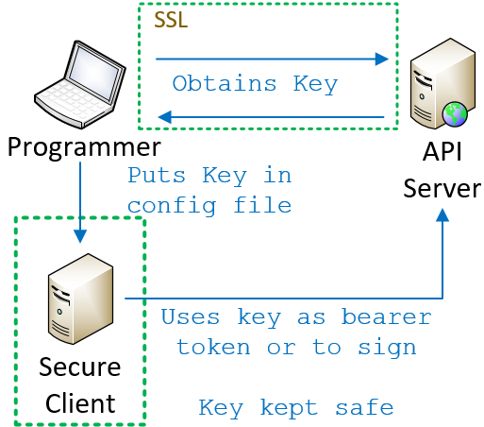
API Keys: Great for server-based clients
Notes:
The last detail of an API Key implementation that you need to think about: how does the client come to know the key in the first place?
Regardless of whether you’re using bearer tokens or HMAC, the client must know the secret value. That knowledge is the key to authentication taking place.
If you’re writing a server-based client it’s easy.
* Programmer obtains the secret value using some secure mechanism * Puts it into the source code or config file for the client.
The client is secure, so as long as you’re either using bearer tokens and TLS or HMAC, the key itself is never exposed.

Slide 35
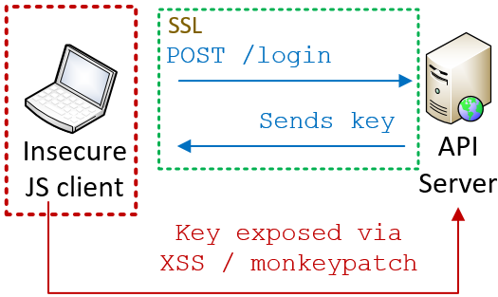
API Keys: Less great for JS clients
Notes:
More complicated for a JS client. No way to pre-load key up front; users can log in from any browser
You could require user to actively authenticate by logging in. Then, send API key back to client
Problem is client cannot securely store the key – JS is not secure env. Crypto functions can be monkey patched, local storage susceptible to XSS
Assume that anything you expose to JS is open for inspection
So if we can’t store the API keys in JS, how do we secure an API for a JS client?

Slide 36
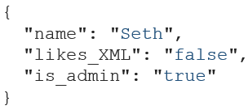
JWT: Secure tokens for JS clients
Open, industry standard method for securely representing claims between two parties
Notes:
One answer is JSON Web Tokens, pronounced “JOT”.
JSON Web Tokens are an open, industry standard method for securely representing claims between two parties.
“Claims” are nothing more than pieces of data; they might be demographic such as a name, they might be user preferences, or they might be statements about what the user is allowed to do in the system. And since this standard is called “JSON” Web Tokens, the claims are obviously expressed using JSON.
Once those claims are generated, the server cryptographically signs the claims just like we saw with HMAC and creates a token. It gives that token to the browser, and the browser resends the token back to the server with each request. The server then validates the token and then uses the claims as needed, for instance to perform authorization.

Slide 37
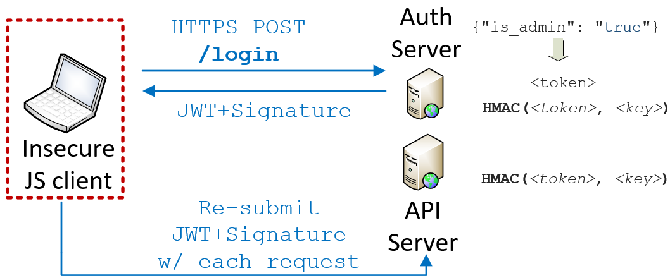

JWT: Secure tokens for JS clients
Notes:
Let’s walk through that again in a little more detail.
Using JWT, the user still needs to securely authenticate themselves by logging in. And, it goes without saying, that login is performed over a secure connection so that the user credentials are kept safe in transit.

Slide 38
JWT: Secure tokens for JS clients
Notes:
Once the server validates the credentials and confirms the identity of the request, it then creates a JSON document indicating that the user has authenticated and specifying the permissions they have in the system.
The values in this document are called “claims”.

Slide 39
JWT: Secure tokens for JS clients
Notes:
The server then uses its private encryption key to sign that token, just like we saw with request signing using HMAC. In this case though, the encryption key is known only to the server, not the client.

Slide 40
JWT: Secure tokens for JS clients
Notes:
The server then responds to the login request, sending both the token and the signature. The client might store the token in memory or in a cookie; we’ll talk about that in a minute.

Slide 41
JWT: Secure tokens for JS clients
Notes:
Finally, the client re-submits the token and signature with every subsequent request. Upon receiving a request that contains a token, the server re-computes the signature using its private key and validates the result against the signature provided by the client.
If the signature matches then the server knows those claims are valid; they could only have been signed by someone in possession of that private key. If the claims in the token had been modified in any way the signature wouldn’t match.
Again, this is very similar to signing API keys, except in this case only the server knows the secret key. The client’s job is just to store and re-submit the token.

Slide 42
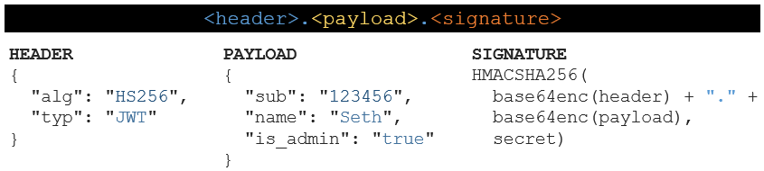

Format of a JWT token
Notes:
JWT tokens consist of 3 pieces of data, separated by a period.
First is a standard header that typically indicates the type of token and the hashing algorithm being used. In this example we’re using HMAC SHA256, but other options exist.
In fact, the ability for the client to choose which hashing algorithm should be used is a core piece of the JSON Web Token standard. It's also one of the reasons that some security experts don't like JWT, although a discussion of those concerns is out of scope for this talk.

Slide 43
Format of a JWT token
Notes:
The second piece of data is the payload, which contains the actual claims you’re making.
The JWT spec defines a handful of predefined claims called “registered claims”. These are optional but are recommended if you want your tokens to be more easily used between disparate systems. For instance, in this example here I’m using the “subject” claim to represent the ID of the user that logged in.
In addition to those predefined claims you can also create private claims to fit your own needs. In this example “name” and the “is_admin” flag are private claims.

Slide 44
Format of a JWT token
Notes:
The third piece of data is the signature, which is calculated by combining the header and payload together and then running them through the hashing function.

Slide 45
Format of a JWT token
Notes:
Finally, the base64-encoded header, the base64-encoded payload, and the signature are all concatenated together with periods, resulting in the final token.
This string right here is what gets sent back to the browser, and is then echoed back to the server on subsequent requests, usually in an Authorization header.
The really cool thing about this is that these claims make JWT tokens self-contained and stateless; rather than just saying “the user ID is 12” and relying on the server to figure out what permissions user 12 has, the JWT token itself can state those permissions. This can really help with performance because everything the server needs for authentication and authorization can be contained directly in the token, avoiding the need for additional database lookups to authorize a request.

Slide 46

Format of a JWT token
Claims are visible to client!
Notes:
It’s important to note that even though the token looks like gibberish, the header and payload are encoded but not encrypted. This means that anyone that gets access to that token will be able to read the claims that it contains.
This brings up some interesting trade-offs regarding where you store the token between requests, and what sort of access your JS code has to it.

Slide 47
Storing JWT on the JS client
Don’t put tokens w/ sensitive data into LocalStorage!
 | Safe from XSS? | Safe from CSRF? | App can access token payload?
LocalStorage | ✗ | ✓ | Yes
httpOnly secure cookie | ✓ | ✗ (easy to address) | No
Notes:
Once the server sends your JS client a JWT token, you can either store it in LocalStorage or in a cookie.
The advantage of LocalStorage is that your JS code can access the claims. This is useful if the token contains data that you need for purposes other than API authentication and authorization, such as the user’s preferences or email address or something. The downside is that information stored in LocalStorage is vulnerable to cross-site scripting attacks, so you should only store tokens there if the payload doesn’t contain sensitive values.
Alternatively, you could put the token into an httpOnly secure cookie. This way, the token is protected in transit by TLS, and by definition an httpOnly cookie will be inaccessible to Javascript. However, that means that the token can only be used for server-side authentication and authorization and you can’t use the token to make data available to your JS app.

Slide 48
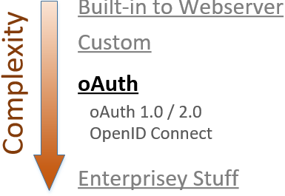
Notes:
At this point we’ve discussed some authentication schemes that are supported natively by the web server itself and we’ve discussed some custom systems based around API Keys. Next on the agenda is Oauth.
OAuth builds on many of the concepts we just saw, but it’s a definite step up in complexity.
We’re going to discuss a few different things: the difference between 2- and 3-party authorization, the differences between OAuth versions 1.0 and 2.0, and what it means for OAuth to be an authorization framework, not an authentication one.

Slide 49

Client/server authentication (2-legged)
Client is resource owner; access its own data
Notes:
OAuth was originally designed to solve the problem of “delegated authorization” in a 3-party scenario.
To explain that, let’s first review the traditional 2-party scenario you see here.
Client uses ITS credentials to access ITS resources on the server. In OAuth parlance, this is a “2-legged” model because there are two entities involved. One scenario that uses this model is server-to-server communication.

Slide 50
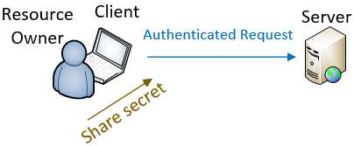
Delegated authorization (3-legged)
Client acts on behalf of the resource owner
Notes:
In other cases, the client is acting ON BEHALF OF another entity, such as the person using the browser.
In those cases, client is not accessing its own resources but those of the user.
To do this, the user must share their credentials with the client so that the client can use them to make the authenticated request.
That’s fine if you trust the client, and you don’t mind the client impersonating you when it talks to the server.

Slide 51
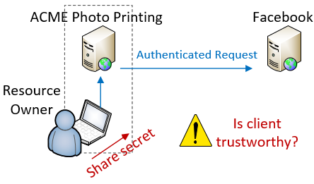
Delegated authorization (3-legged)
Notes:
But what if you DON’T trust the client with your credentials?
Let’s say you have some photos that you’ve uploaded to Facebook and you want to use an online photo printing service to create greeting cards using those photos.
You really don’t want to give ACME your Facebook username and password, but how else does it make the authenticated request on your behalf?

Slide 52
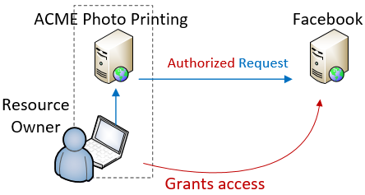
Delegated authorization (3-legged)
Notes:
This is the exact scenario that OAuth was designed for.
“3-legged” model because there are 3 parties involved: the Resource Owner that owns the content, the Service Provider that hosts the content, and the Client that accesses the content.
OAuth allows me to authorize ACME to access my FB photos, but without sharing my actual credentials.
When I do this, ACME is no longer making an AUTHENTICATED request, its making an AUTHORIZED request. We’ll talk about this in a minute.

Slide 53

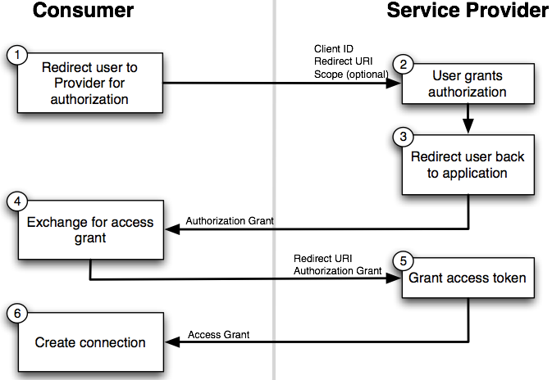
Notes:
Here’s how it works. The user starts out on the client’s website, ACME photos. ACME redirects the user to the provider (Facebook)
The user first authenticates themselves to Facebook
Facebook displays a page to the user to collect authorization, which looks like this

Slide 54
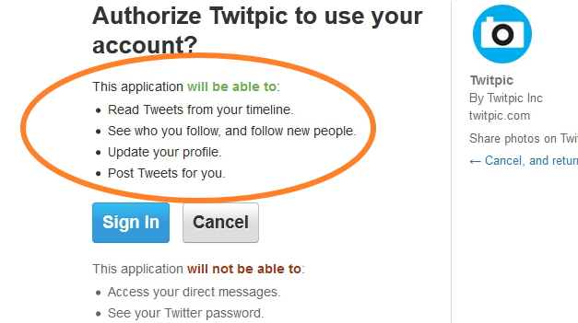
Notes:
This page is hosted by the authorization server, which presumably you trust. It explains the sorts of access that you are authorizing.
If you choose to authorize the access, the OAuth flow continues.

Slide 55
Notes:
User authorizes the access ➔ redirects back to the client with an “authorization grant”.
Client makes another call to service and trades auth grant for an access token
transition
* There are 2 versions of OAuth and they solve this problem in very different ways
* Not universally accepted that the newer version is best

Slide 56
OAuth 1.0a
Uses signed requests (TLS not req. / integrity guaranteed)
3-legged “flow” works best with web-based clients
Complex to implement – use libraries!
Notes:
OAuth 1.0 was published April 2010 and the 1.0a version came out shortly after.
In technical terms, implemented using signed requests.
Does not require TLS
Message integrity is guaranteed
Works best w/ web-based clients b/c user must be sent to a website to do the auth
Primary drawback complexity from signing
Mitigated a little by libraries, but still a lot of work

Slide 57
OAuth 2.0
Not backwards compatible with 1.0/1.0a
No HMAC signatures == simpler to implement
Delegates security entirely to TLS
Better support for enterprise & non-web clients
Notes:
OAuth 2.0 was designed to address those drawbacks. It is an entirely different implementation and the two are not compatible.
Major difference is simplicity
Uses bearer tokens instead of request signing
Requires TLS to keep the tokens safe in transit
OAuth 2.0 also has better support for non-web clients and enterprise use cases.
Provides more “flows” than 1.0
Means there are more supported authentication workflows that can be supported

Slide 58
OAuth 2.0 – drawbacks
OAuth 2.0 is a framework, not a protocol; less interoperable than 1.0a
Notes:
It’s important to note that the 2.0 spec is considered a framework rather than a protocol.
In order to support the wider range of authorization workflows, many decisions are left to implementers
This hurts interoperability.
Two providers may say they are OAuth 2 compliant, and have very different actual implementations
Code you write for one provider may require a lot of work to support a different provider

Slide 59
OAuth 2.0 – drawbacks
OAuth 2.0 and the road to Hell
“When compared with OAuth 1.0, the 2.0 specification is more complex, less interoperable, less useful, more incomplete and, most importantly, less secure.”
Eran Hammer, former lead author of OAuth working group
http://hueniverse.com/2012/07/26/oauth-2-0-and-the-road-to-hell/
Notes:
There’s some controversy around 2.0 as well.
Eran Hammer was the lead author for the OAuth working group
withdrew his name from the 2.0 specification prior to publishing
“OAuth 2.0 and the Road to Hell”

Slide 60
Use OAuth 2.0 if…
OAuth 2.0 and the road to Hell
“If you consider yourself a security expert, use 2.0 after careful examination of its features. If you are not an expert, copy an implementation of a provider you trust… or make sure you have some security experts on site to figure it out for you.”
Eran Hammer, former lead author of OAuth working group
http://hueniverse.com/2012/07/26/oauth-2-0-and-the-road-to-hell/
Notes:
He goes on to say “If you consider yourself a security expert, use 2.0 after careful examination of its features. If you are not an expert, copy the implementation of a provider you trust to get it right or make sure you have some security experts on site to figure it out for you”.
This might just be sour grapes or a difference in vision for OAuth.
Make sure you research before choosing OAuth 2

Slide 61
OAuth is not an authentication protocol!
Notes:
Let’s talk about authentication vs authorization again.
OAuth is a standard for delegating authorization to an API.
About you, as a Resource Owner, authorizing one application to access your data from another application.
It is not an authentication protocol and should not be used as one, for two reasons.

Slide 62
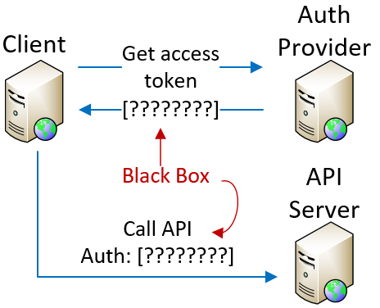
Access tokens are opaque - don’t provide ID
Notes:
First, whole point of authentication is to securely assign an identity to a request.
OAuth access tokens don’t tell the client anything about user identity.
By definition, access tokens are opaque to the client.
Client gets token from auth provider
Client uses token to make API calls
Token itself is a black box – client can’t parse it or extract data
Therefore, the access token alone cannot tell us WHO is making the request, and there is no authentication without a “who”

Slide 63
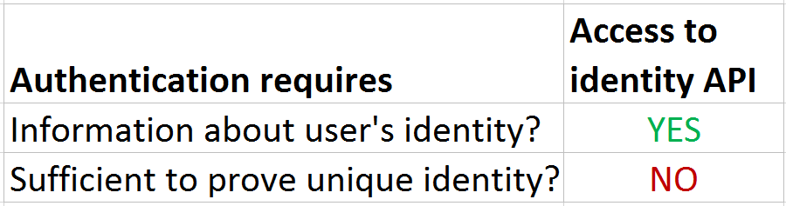
Access to identity API != authentication
Notes:
But what if the access token authorizes you to call an API that will provide user identity information?
If you have a token, & token authorized to obtain identity information, is that sufficient for authentication?
NO, because no guarantee that only that user was able to authorize that access. If more than one entity can delegate access to that identity API, then you can’t assume that your authorization is sufficient for authentication
This might be easier to understand with an example.

Slide 64
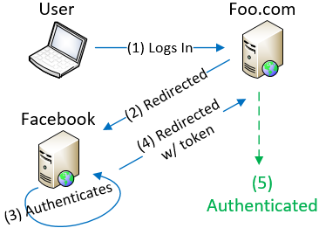
Access tokens lack audience restrictions
Notes:
Let’s say there is a website that lets people “log in with Facebook”.
I go to Foo.com and follow normal OAuth flow and authenticate against Facebook,
I authorize Foo.com to access my data and get redirected back to Foo.com with an access token.
Foo.com uses token to call Facebook’s API, gets my email address, and considers me logged in to FOO
I have given Foo access to my profile and in exchange, Foo gives me access to my account on FOO
At this point, I have access to my full FOO account

Slide 65
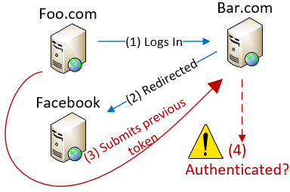
Access tokens lack audience restrictions
Notes:
Let’s say Foo.com isn’t trustworthy. It turns around and makes a login request against Bar.com, which also allows Facebook logins.
Instead of going through Auth process, Foo resubmits the access token they obtained from my authorization
Bar uses that access token to call Facebook’s API and is given my data
Bar then assumes that Foo has authenticated as me, so Foo is logged in and given access to my account with BAR
Neither Foo nor Bar have more access to FB data than was authorized
Foo has impersonated me at BAR and can access Bar’s data associated with my account
Possible because OAuth access tokens do not have audience restriction. This is a problem with bearer tokens, Bar doesn’t know that the access token is being misused.

Slide 66
Access token != authentication
DO NOT use resource authorization as proof of authentication
Notes:
To avoid that problem, ONLY use access tokens to access the authorized resource.
If you use possession of an access token as proof of authentication, you are vulnerable.
To solve this problem, the access token would need to
assert which client it was granted to and
which authenticated identity authorized it
That way, only that one authorized client would be able to use the token, and the token itself would be proof of identity

Slide 67
OpenID Connect
Open standard, built on top of OAuth 2.0
ID Tokens – gives authentication data to client
Audience restrictions
Enables authentication against 3rd party identity providers
Notes:
That’s the basic concept behind OpenID Connect.
Open standard that defines an interoperable identity layer on top of OAuth 2.0.
Allows authentication against 3rd party identity providers by closing some of the gaps we just mentioned.
ID Connect adds extra tokens which are given to client in addition to regular OAuth access token.
These have well-known format so the client can extract identity claims and audience restrictions directly from the token.
OpenID Connect replaces OpenID 2.0 and is the best way to implement something like “Log in with Google” on your app.

Slide 68
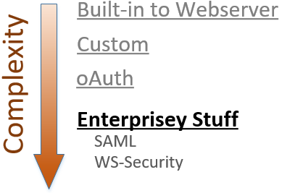
Notes:
To wrap up our review of authentication options I want to touch very briefly on two additional techniques that you might want to be aware of.
The first is SAML, which stands for “Security Assertion Markup Language”. It provides similar functionality as JSON Web Tokens in that it allows for the secure exchange of authentication and authorization data between different parties, but using SOAP and XML rather than JSON over HTTP. SAML is significantly older and more complex than JWT, but it does offer some additional functionality such as additional transport protocols and different types of encryption. SAML is very commonly used for enterprise single-sign-on scenarios, although JWT is starting to see some adoption in this area.
The second is WS-Security, and honestly I don’t know much about it. If you’re dealing with very complex, enterprise-grade authentication scenarios then you might want to hire a security expert to help. It’s probably safe to say that nobody attending my 101-level intro to authentication systems has any business implementing WS-Security in PROD without a little help.

Slide 69
So what should you use?
Notes:
OK, so I just threw a metric crapton of information at you. We talked about a lot of different authentication choices with a lot of different trade-offs. Like most things in this industry, the correct answer to this question is “it depends”.

Slide 70
Choose your own adventure
Consider client certificates if…
You’re using IIS + Active Directory to secure a private API on trusted network, or
You want server-to-server authentication w/out passwords
Notes:
Client certificates are pretty easy to use, IF you can get your users to install them.
If you’re securing a private API on a trusted network, and you’re authenticating against Active Directory, then this is a really nice way to avoid login prompts altogether.
Client certificates are also a nice option for server-to-server authentication.

Slide 71
Choose your own adventure
Consider HTTP Basic Auth if…
You're authenticating server-to-server API calls using a standard database, like ActiveDirectory, & you want to write as little code as possible
Notes:
If you're authenticating server-to-server API calls against a standard user database such as ActiveDirectory, then Basic Auth is worth considering.
Basic Auth is not a good idea for a pure JS client because it requires storing the credentials somewhere in browser memory, which is generally a bad idea.

Slide 72
Choose your own adventure
Consider HTTP Digest Auth if…
Don’t. Just don’t.
Notes:
There’s no good reason to use Digest Auth. Anyone that tells you to do this is about 15 years out of date.

Slide 73
Choose your own adventure
Consider API Keys as bearer tokens if…
You value simplicity over security
You can use TLS for all requests
Notes:
Using API Keys as “bearer tokens”, where you pass the key itself with each request, is really easy to implement so it’s great for rapidly standing up a new API when you don’t need top-notch security.
The primary drawbacks to bearer tokens are that you’re sending the credentials over the wire with every request, and there’s no way to validate the authenticity of a message that you receive. Using TLS can help by protecting credentials in transit, but that may not be enough if security is very important to your API.

Slide 74
Choose your own adventure
Consider signed requests using API Keys if…
You want extra security vs bearer tokens, and
You can thoroughly document the signing process
Notes:
If you want more security than you get with bearer tokens, then use API Keys to sign requests.
Remember that creating the signature can be complex and requires that the client and server create the hash in exactly the same way. If you’re dealing with 3rd party clients, you may find that documenting and supporting the canonicalization process is more trouble than its worth, so rolling your own HMAC approach might be best if you’re writing both the client and server yourself.

Slide 75
Choose your own adventure
Consider JSON Web Tokens if…
You're writing a JS client, or
You want a standards-based, self-contained, stateless alternative to in-memory "sessions"
Not a good fit for automated, server-to-server interaction
Notes:
JSON Web Tokens might be a good fit if you’re writing a JS client or you want a standards-based, self-contained, stateless alternative to in-memory sessions on the application server.
If API performance is a mission critical concern for you then JWT may help you reduce your database lookups by storing commonly-queried data in the token itself.
Remember that this does require a secure login with user-entered credentials to initialize the token, so JWT isn’t a good fit for automated, server-to-server interaction. (Or more accurately, JWT is a fine way to handle authorization in a server-to-server model, but it relies on something else to handle the initial authentication)

Slide 76
Choose your own adventure
Consider OAuth 1.0a if…
You need to support delegated access to user data, and
You can’t/don’t want to require TLS
You care about client/provider interoperability
Notes:
OAuth is a good fit if you need to support delegated access to user data.
You should consider the 1.0 version if you can’t, or don’t want to, rely on TLS for security, or if you care about client/provider interoperability. For instance, if you want to support clients that can connect to multiple API providers with just a few configuration changes.
The primary drawbacks with OAuth 1.0 are the complexity involved in making signed requests and limited support for non-browser clients, so make sure you’re prepared to deal with that complexity. 3rd party libraries can help with that.

Slide 77
Choose your own adventure
Consider OAuth 2.0 if…
You need to support delegated access to user data, and
You want to avoid complexity of signed requests, and
You can require TLS on all requests
You need to support a wider set of devices and “flows”
Notes:
If you care more about flexibility and simplicity than operability and security, and you can require TLS on all requests, then OAuth 2.0 is a better fit than 1.0. 2.0 is also a better fit if you want to support a wider set of devices and authentication flows.
The primary drawbacks to OAuth 2.0 are reduced security relative to 1.0, and less interoperability as a result of having greater flexibility. Writing a client that can interact with multiple authentication providers will be harder using 2.0 than with other options.

Slide 78
Choose your own adventure
Consider OAuth 2.0 + OpenID Connect if…
You need to authenticate against 3rd party identity data
You want to centralize your own authentication and identity systems
You want SSO without SAML
Notes:
Remember that OAuth by itself is for authorization only.
If you want to authenticate against 3rd party data then use OpenID Connect on top of OAuth 2.0. This will let your users authenticate to your API with their Google accounts, for example.
You can also use OpenID Connect if you have multiple internal systems and you want to set up your own centralized Identity and authentication provider.

Slide 79
Choose your own adventure
Consider SAML or WS-Security if…
You find XML to be life-affirming and joyful, or
You have a Legit Reason To Do It The Hard Way ™
Notes:
Lastly, you should use SAML or WS-Security if you have a sick love affair with XML, or if you have one of the very complex scenarios that needs the extra complexity they entail.
If you’re creating an API for your own internal use, or for public use on the open internet, these things are overkill and you should stick to something simpler.

Slide 80
3 key things to remember
Use API Keys as bearer tokens or to sign requests, depending on security/convenience needs
JSON Web Tokens are a secure, stateless way to share non-sensitive data. Careful about XSS/CSRF!
OAuth is for authorization, not authentication. Use OpenID Connect if you need both
Notes:
Research shows that attendees of a talk such as this will only remember 3 things. That means that most of the information I just shared with you will vanish quickly if you don’t act on it.
So here are the 3 most important things I want you to remember:
You can use custom API keys as bearer tokens over TLS for a quick and easy approach, or you can use API Keys to sign request using HMAC if you need additional security.
JSON Web Tokens are a secure, stateless way to share non-sensitive data. Remember that by default tokens are encoded, not encrypted, so anything you put in them can be decoded by the client. You also need to make sure your tokens aren’t vulnerable to cross-site scripting or cross-site request forgery.
Lastly, OAuth is for authorization, not authentication. Use OpenID Connect if you need both.

Slide 81
That’s all, folks!
Materials
www.petry-johnson.com
github.com/spetryjohnson
Contact
@spetryjohnson
seth@petry-johnson.com
Notes:
Actually, you all look like smart people, so I want you to try really hard to remember a 4th thing, and that’s my GitHub link. That's where these slides are kept along with all of my speaker notes.
Please feel free to reach out with feedback, questions, comments, etc. I’d love to hear from you.
THANK YOU!

